Slide 1

Chapter 21
Network Layer:
Address Mapping,
Error Reporting,
and Multicasting
21.<number>
Copyright © The McGraw-Hill Companies, Inc. Permission required for reproduction or display.

Slide 2
21-1 ADDRESS MAPPING
The delivery of a packet to a host or a router requires two levels of addressing: logical and physical. We need to be able to map a logical address to its corresponding
physical address and vice versa. This can be done by using either static or dynamic mapping.
Topics discussed in this section:
Mapping Logical to Physical Address
Mapping Physical to Logical Address
21.<number>

Slide 3

Figure 21.1 ARP operation
21.<number>

Slide 4

Figure 21.2 ARP packet
21.<number>

Slide 5
ARP Packet Fields
Hardware Type: 16 bit field defining the type of network in which ARP is running. Ethernet is given type 1.
Protocol type: 16 bit field defining the protocol with which ARP is running.
Hardware Length: 8 bit field defining the length of the physical address. For ethernet he value is 6.
Protocol Length: 8 bit field defining the length of the logical address. For IPv4 the value is 4.
21.<number>

Slide 6
ARP Packet Fields (Contd)
Operation: 16 bit field defining the type of packet. ARP request or ARP reply.
Sender Hardware Address: variable length field, physical address of the sender.
Sender Protocol Address: variable length field, Logical address of the sender.
Target Hardware Address: variable length field, physical address of the target. Contains 0 in request packet.
target Protocol Address: variable length field, Logical address of the target.
21.<number>

Slide 7
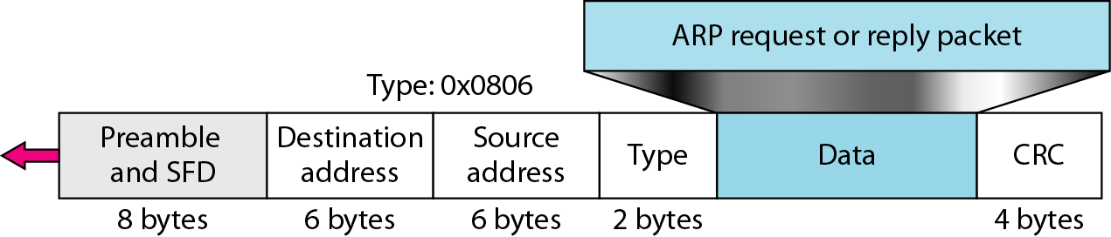
Figure 21.3 Encapsulation of ARP packet
21.<number>

Slide 8
How ARP works?
1- The sender knows the IP address of the target.
2- IP asks ARP to create an ARP request message. (Discussed in previous slide)
3- The message is passed to the data link layer where it is encapsulated in a frame by using the physical address of the sender as the source address and the physical broadcast address as the destination address.
4- All Stations remove the message and pass it to ARP. All machines except the targeted one drop the packet.
21.<number>

Slide 9
How ARP works? (Contd)
5- The target machine replies with an ARP reply message that contains its physical address. Unicast message.
6- Sender receives the reply message. It now knows the physical address of the target machine.
7- The IP datagram, which carries data for the target machine , is now encapsulated in a frame and is unicast to the destination.
21.<number>

Slide 10

Figure 21.4 Four cases using ARP
21.<number>

Slide 11
Case 1:
The sender is a host and wants to send a packet to another host on the same network.
Now, the logical address that must be mapped to a physical address is the destination IP address in the datagram header.
21.<number>

Slide 12
Case 2:
The sender is a host and wants to send a packet to another host on the another network.
Now, the hosts looks at its routing table and finds the IP address for the next router for this destination. If does not have a routing table, looks for the IP address of the default router.
The IP address of the router becomes the logical address that must be mapped to a physical address.
21.<number>

Slide 13
Case 3:
The sender is a router that has received the datagram destined for a host on another network.
Now, it checks its routing table.
The IP address of the next router becomes the logical address that must be mapped to a physical address.
21.<number>

Slide 14
Case 4:
The sender is a router that has received the datagram destined for a host on the same network.
The destination IP address of the datagram becomes the logical address that must be mapped to a physical address.
21.<number>

Slide 15

Note
An ARP request is broadcast;
an ARP reply is unicast.
21.<number>

Slide 16
Example 21.1
A host with IP address 130.23.43.20 and physical address B2:34:55:10:22:10 has a packet to send to another host with IP address 130.23.43.25 and physical address A4:6E:F4:59:83:AB. The two hosts are on the same Ethernet network. Show the ARP request and reply packets encapsulated in Ethernet frames.
Solution
Figure 21.5 shows the ARP request and reply packets. Note that the ARP data field in this case is 28 bytes, and that the individual addresses do not fit in the 4-byte boundary. That is why we do not show the regular 4-byte boundaries for these addresses.
21.<number>

Slide 17

Figure 21.5 Example 21.1, an ARP request and reply
21.<number>

Slide 18

Figure 21.6 Proxy ARP
21.<number>

Slide 19
Mapping Physical to Logical
There are occasions in which a host knows its physical address, but needs to know its logical address.
RARP
BOOTP
DHCP
21.<number>

Slide 20
RARP (Reverse Address Resolution Protocol)
RARP finds the logical address of the machine that knows only its physical address.
An RARP request is created and broadcast on the local network.
Another machine on the local network that knows all the IP addresses will respond with RARP reply.
Requesting machine should run RARP client program and the answering side should be using RARP server program.
Serious problem: Broadcasting is done at the data link layer that cannot pass the boundaries of network. So administrator needs to run RARP servers if having several networks.
21.<number>

Slide 21
BOOTP (Bootstrap Protocol)
Its is a client/server protocol.
Runs on the application layer.
Administrator having different networks can easily use this protocol.
BOOTP request is broadcasted. Broadcasted IP datagram cannot pass through any router. So intermediary host is introduced called Relay Agent.
Relay Agent unicast the request to the BOOTP server.
21.<number>

Slide 22
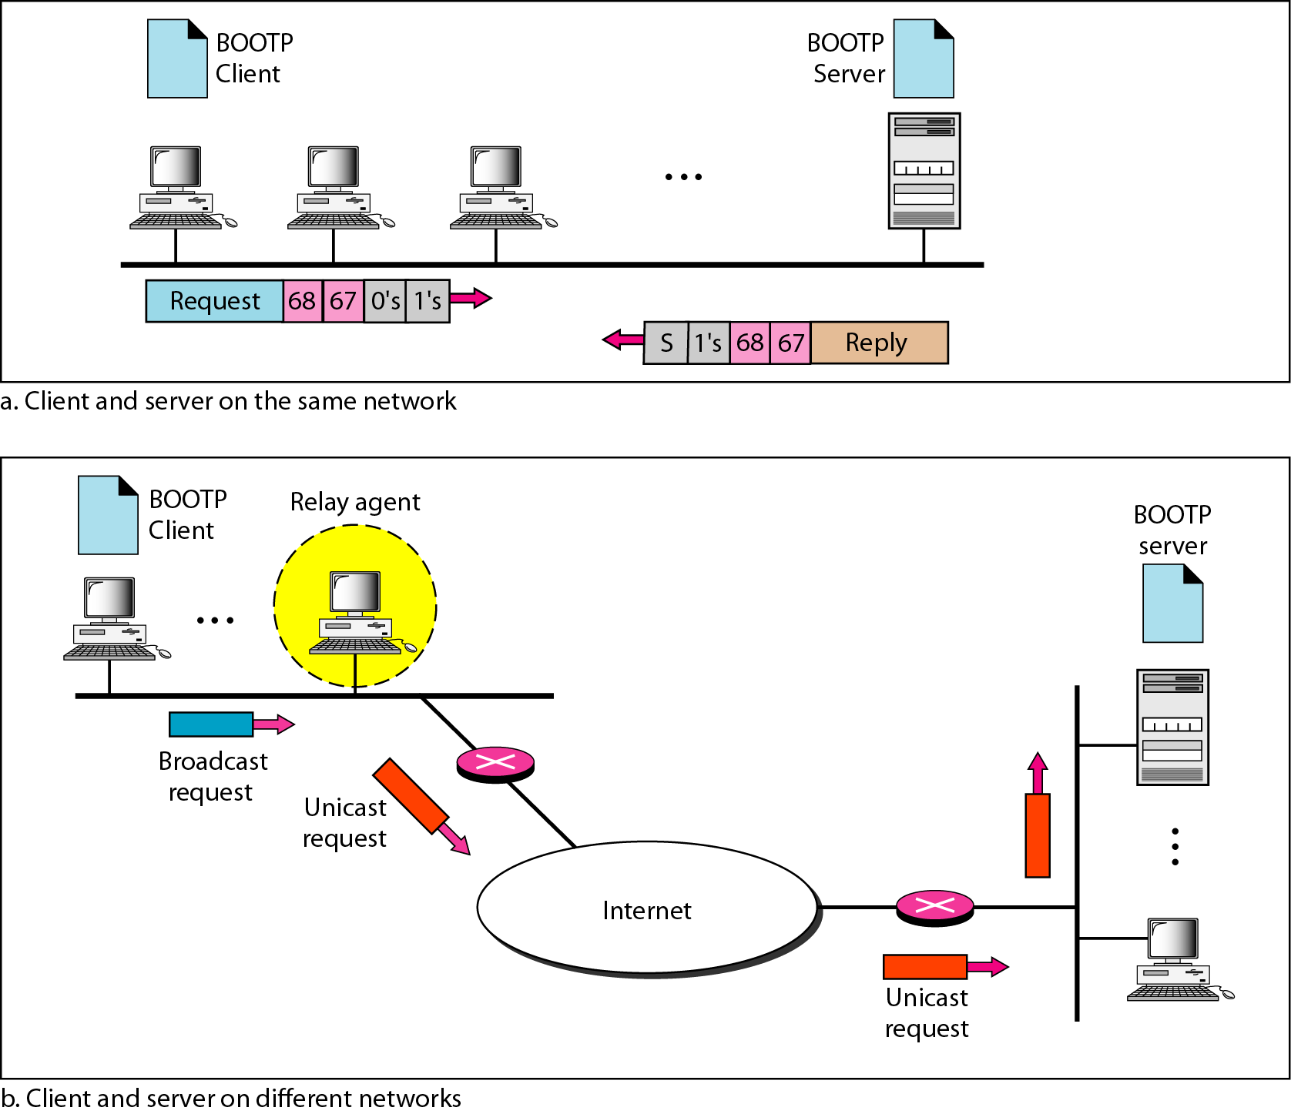
Figure 21.7 BOOTP client and server on the same and different networks
21.<number>

Slide 23
Note
DHCP provides static and dynamic address allocation that can be
manual or automatic.
21.<number>

Slide 24
DHCP (Dynamic Host Configuration Protocol)
BOOTP is not a dynamic configuration protocol. When a client requests its IP address, the BOOTP server consults the table.
What if a host moves one physical address to another?
What if a host needs temporary address?
21.<number>

Slide 25
DHCP (Dynamic Host Configuration Protocol)
Static Address Allocation
  Acts as BOOTP.
Dynamic Address Allocation
Have a database with available IP addresses.
When a DHCP client sends a request to DHCP server, its first check its static database, if yes then assigned the client, if not then send him any available IP address.
21.<number>

Slide 26
21-2 ICMP
The IP protocol has no error-reporting or error-correcting mechanism. The IP protocol also lacks a mechanism for host and management queries. The Internet Control Message Protocol (ICMP) has been designed to compensate for the above two deficiencies. It is a companion to the IP protocol.
Topics discussed in this section:
Types of Messages
Message Format
Error Reporting and Query
Debugging Tools
21.<number>

Slide 27
Types of Messages
ICMP messages are divided into two broad categories.
  Error Reporting Messages
    They report problems that a router or host may encounter when it processes and IP packet.
  Query Messages
    They help a host or a network manager to get specific information from a router or from another host.
21.<number>

Slide 28

Figure 21.8 General format of ICMP messages
21.<number>

Slide 29
Note
ICMP always reports error messages to the original source.
21.<number>

Slide 30
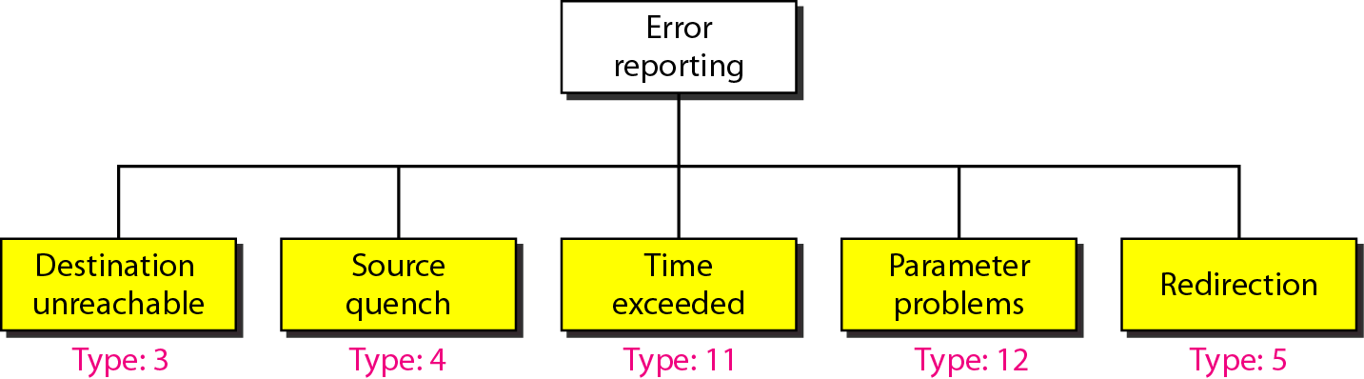
Figure 21.9 Error-reporting messages
21.<number>

Slide 31
Destination Unreachable
When a router cannot route a datagram or a host cannot deliver a datagram, the datagram is discarded and the router or host sends a “Destination Unreachable” message back to the course host that initiated the datagram.
21.<number>

Slide 32
Source Quench
IP is a connectionless protocol. So it does not have any flow control mechanism.
The router or a host has a limited size queue (Buffer) for incoming datagrams waiting to be forwarded or to be processed.
The “Source Quench” message in ICMP was designated to add a kind of flow control to the IP.
When a router or hosts discards a datagram due to congestion, it sends a “Source quench” message to the sender of the datagram.
  This message informs the source that the datagram has been discarded.
  Secondly, it warns the source that there is congestion somewhere in the path and the source should slow down the sending process.
21.<number>

Slide 33
Time Exceeded
This message is generated in two cases.
  When the Time to Live Field (IP datagram) reaches 0, the router discards the packet and generate the “Time Exceeded” message.
  It is also generated when not all fragments that make-up a message arrive at the destination host within a certain time limit.
21.<number>

Slide 34
Parameter Problem
Any ambiguity in the header part of a datagram can create serious problems as the datagram travels through the internet.
If the router or the destination host discovers an ambiguity or missing value in any field of the datagram, it discards the datagram and sends a “Parameter Problem” message back to source.
21.<number>

Slide 35
Redirection
Hosts do not take part in routing update process because there are many more hosts than routers. Hosts usually use static routing.
It usually knows the IP address of only one router i-e default router.
The host may send a datagram (destined for another network) to a wrong router.
The router that receives the datagram will forward the datagram to the correct router.
However, to update the routing table of the host, it send the redirection message to the host.
21.<number>

Slide 36
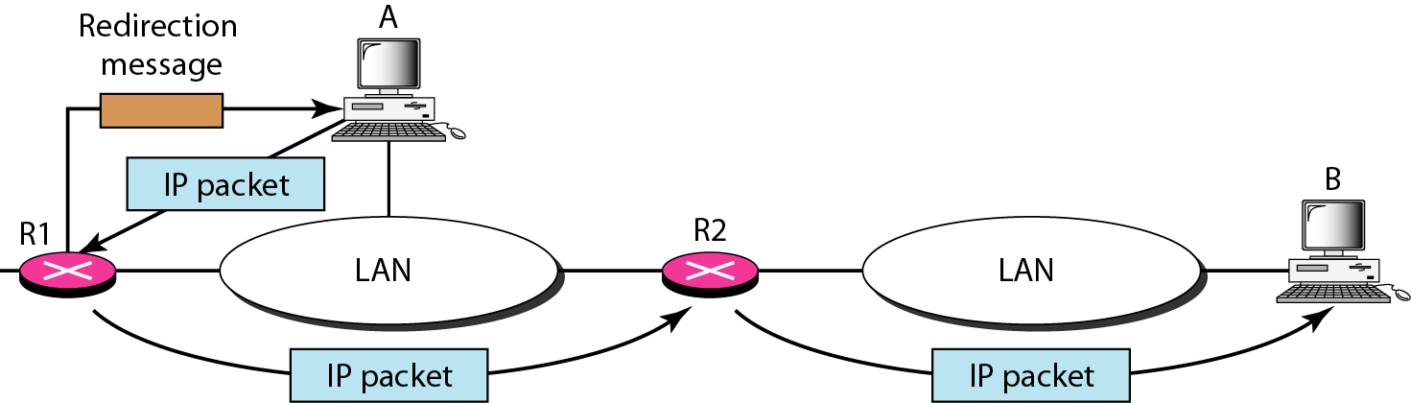
Figure 21.11 Redirection concept
21.<number>

Slide 37
Note
Important points about ICMP error messages:
❏ No ICMP error message will be generated in
response to a datagram carrying an ICMP error
message.
❏ No ICMP error message will be generated for a
fragmented datagram that is not the first fragment.
❏ No ICMP error message will be generated for a
datagram having a multicast address.
❏ No ICMP error message will be generated for a
datagram having a special address such as
127.0.0.0 or 0.0.0.0.
21.<number>

Slide 38
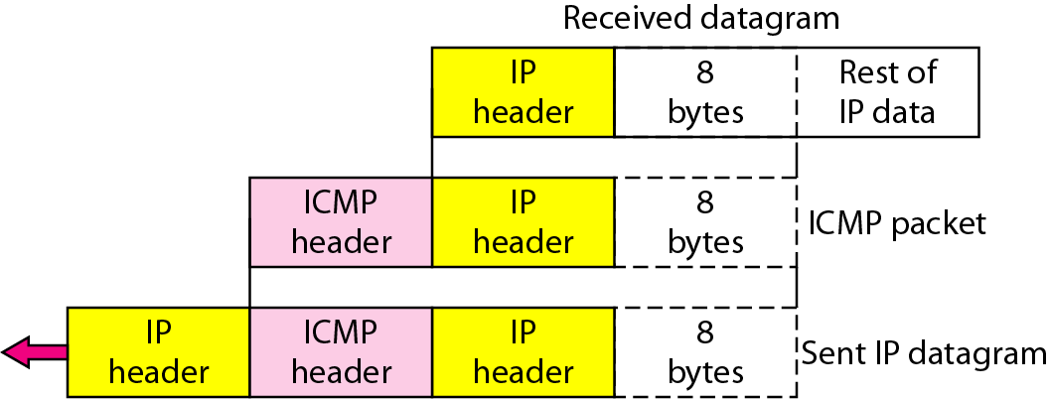
Figure 21.10 Contents of data field for the error messages
21.<number>

Slide 39

Figure 21.12 Query messages
21.<number>

Slide 40
Echo Request and Reply
They designed for diagnostic purpose.
Network managers and users utilize this pair of messages to identify network problems.
They can be used to determine if there is a communication at IP level.
ICMP messages are encapsulated in IP datagrams, the receipt of an echo reply messages by the machine that sent the echo-request is proof that the IP protocols in the sender and receiver are communicating with each other using the IP datagram.
21.<number>

Slide 41
Timestamp Request and Reply
To machines can use this messages to determine the round-trip time needed for an IP to travel between them.
21.<number>

Slide 42
Address-Mask Request and Reply
A host may not know its know its IP address but it may not know its corresponding mask.
To obtain a mask, a host sends an address-mask-request message to a router on a LAN.
Router responds with an address-mask-reply message, providing the necessary mask for the host.
21.<number>

Slide 43
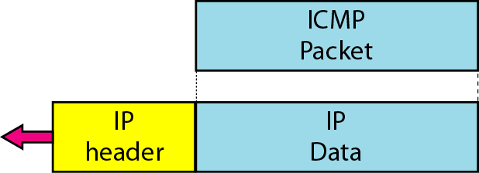
Figure 21.13 Encapsulation of ICMP query messages
21.<number>

Slide 44
Example 21.2
Figure 21.14 shows an example of checksum calculation for a simple echo-request message. We randomly chose the identifier to be 1 and the sequence number to be 9. The message is divided into 16-bit (2-byte) words. The words are added and the sum is complemented. Now the sender can put this value in the checksum field.
21.<number>

Slide 45
Router Solicitation and Advertisement
As host needs to know the IP address of the router to send data on another network.
The host must know of the routers are alive and working.
Router Solicitation and Advertisement messages helps in this situation.
A host can broadcast a router-solicitation message.
The router or routers that receive the solicitation message broadcast their routing information using the router-advertisement-message.
21.<number>

Slide 46
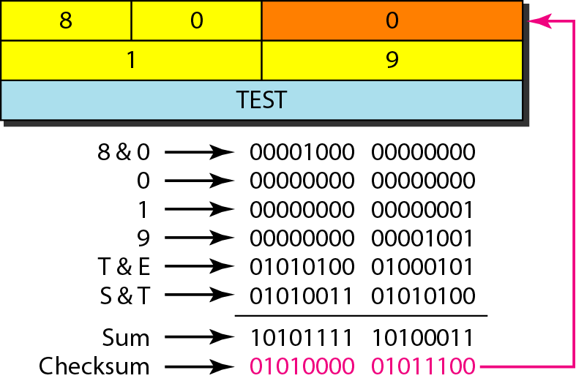
Figure 21.14 Example of checksum calculation
21.<number>

Slide 47
Example 21.3
We use the ping program to test the server fhda.edu. The result is shown on the next slide. The ping program sends messages with sequence numbers starting from 0. For each probe it gives us the RTT time. The TTL (time to live) field in the IP datagram that encapsulates an ICMP
message has been set to 62. At the beginning, ping defines the number of data bytes as 56 and the total number of bytes as 84. It is obvious that if we add 8 bytes of ICMP header and 20 bytes of IP header to 56, the result is 84. However, note that in each probe ping defines the number of bytes as 64. This is the total number of bytes in the ICMP packet (56 + 8).
21.<number>

Slide 48
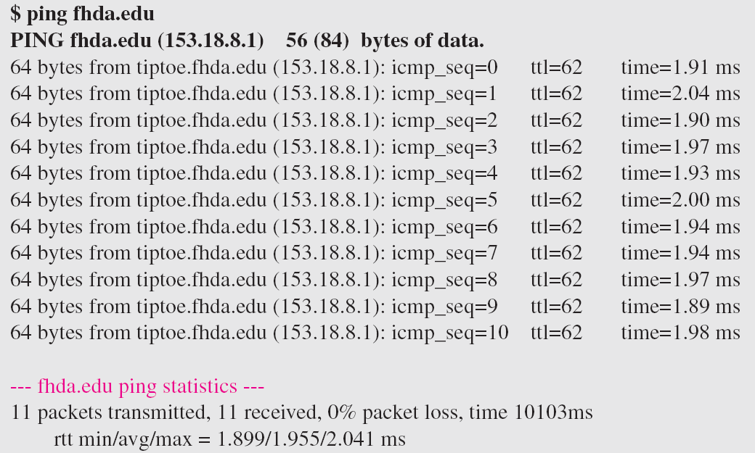
Example 21.3 (continued)
21.<number>

Slide 49
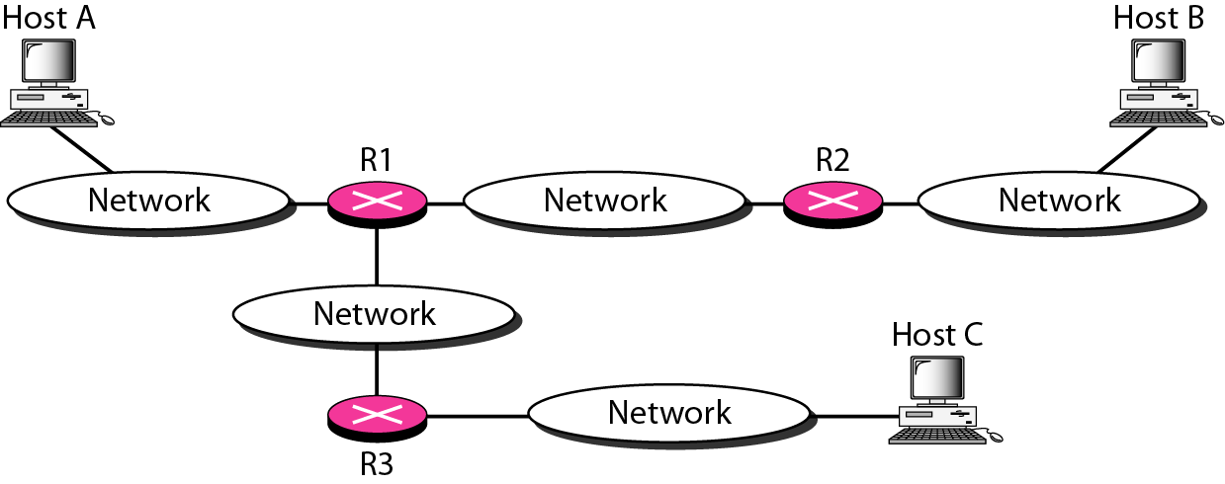
Figure 21.15 The traceroute program operation
21.<number>

Slide 50
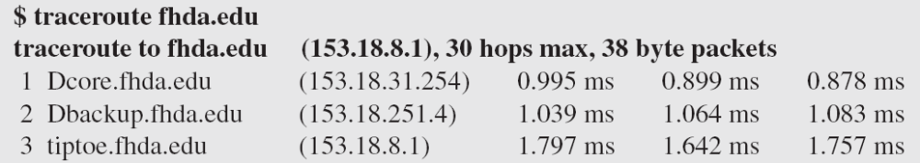
Example 21.4
We use the traceroute program to find the route from the computer voyager.deanza.edu to the server fhda.edu. The following shows the result:
The unnumbered line after the command shows that the destination is 153.18.8.1. The packet contains 38 bytes: 20 bytes of IP header, 8 bytes of UDP header, and 10 bytes of application data. The application data are used by traceroute to keep track of the packets.
21.<number>

Slide 51
Example 21.4 (continued)
The first line shows the first router visited. The router is named Dcore.fhda.edu with IP address 153.18.31.254. The first round-trip time was 0.995 ms, the second was 0.899 ms, and the third was 0.878 ms. The second line shows the second router visited. The router is named Dbackup.fhda.edu with IP address 153.18.251.4. The three round-trip times are also shown. The third line shows the destination host. We know that this is the destination host because there are no more lines. The destination host is the server fhda.edu, but it is named tiptoe.fhda.edu with the IP address 153.18.8.1. The three round-trip times are also shown.
21.<number>

Slide 52
21-3 IGMP
The IP protocol can be involved in two types of communication: unicasting and multicasting. The Internet Group Management Protocol (IGMP) is one of the necessary, but not sufficient, protocols that is involved in multicasting. IGMP is a companion to the IP protocol.
Topics discussed in this section:
Group Management
IGMP Messages and IGMP Operation
Encapsulation
Netstat Utility
21.<number>

Slide 53
IGMP
IGMP is not a multicasting routing protocol; it is a protocol that manages the group membership.
The IGMP protocol gives the multicast routers information about the membership status of the hosts connected to the network.
IGMP helps the multicast router create and update the list.
21.<number>

Slide 54
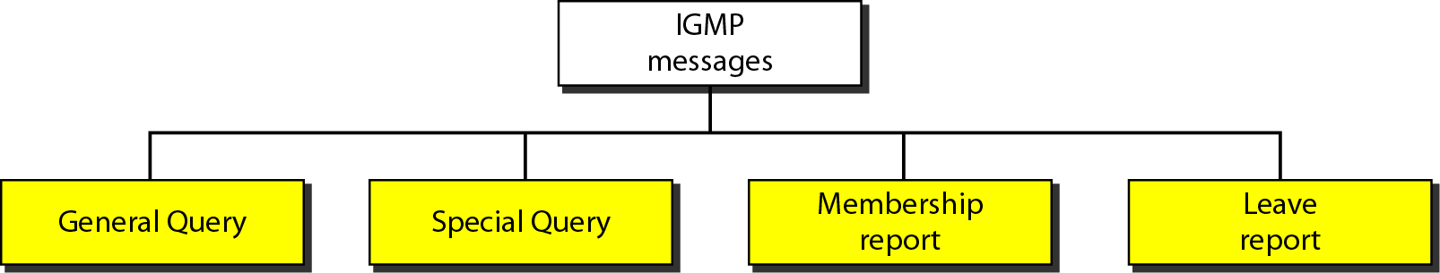
Figure 21.16 IGMP message types
21.<number>

Slide 55
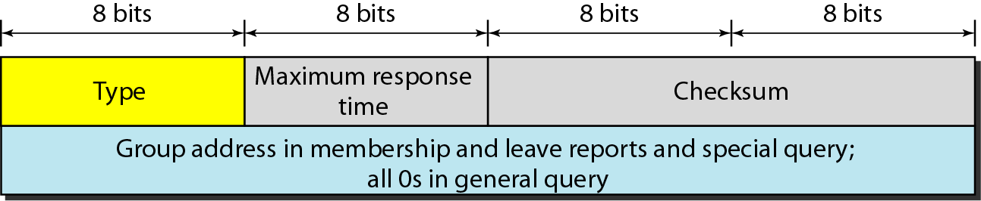
Figure 21.17 IGMP message format
21.<number>

Slide 56
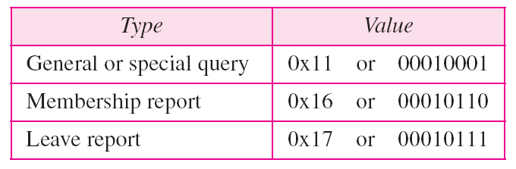
Table 21.1 IGMP type field
21.<number>

Slide 57
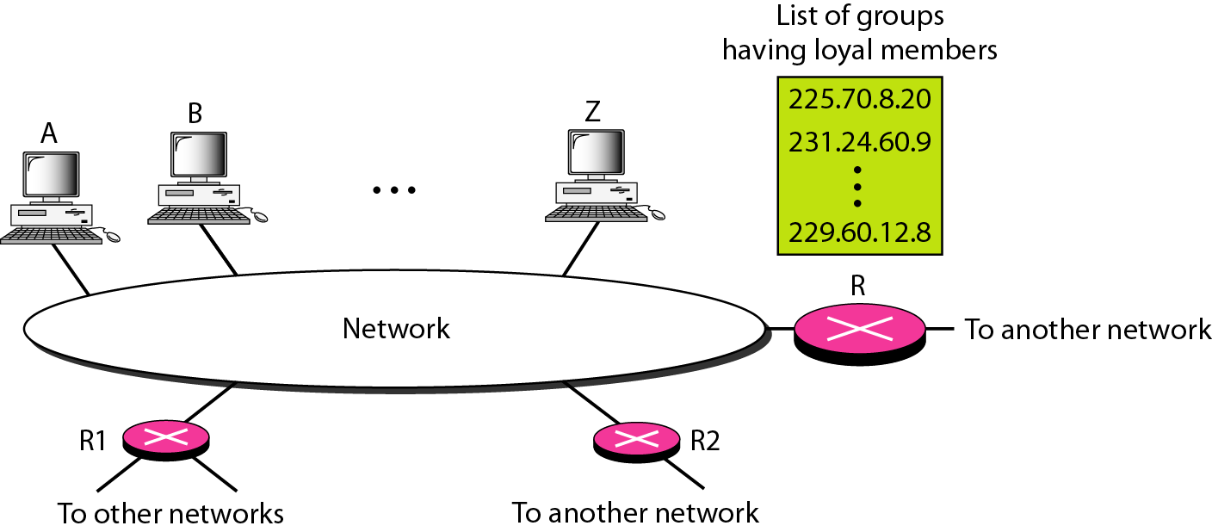
Figure 21.18 IGMP operation
21.<number>

Slide 58
Joining a group
When a process wants to join a group, it sends its request to the host.
The host adds the name of the process and the name of the requested group to its list.
If this is the first entry for this particular group, the host sends a membership report message.
21.<number>

Slide 59
Note
In IGMP, a membership report is sent twice, one after the other.
21.<number>

Slide 60
Leaving a group
When a host sees that no process is interested in a specific group, it sends a leave report.
Similarly, when a router sees that none of its connected networks are interested, it sends a leave report message.
When a multicast router receives a leave report, it cannot immediately purge that group from its list because the report comes from just one host or router. There may be other hosts or routers that are still interested in the group.
To make sure, router sends a special query message with multicast address/ groupid to that group.
Router allows specific time to respond, if no response then it assumes that there is no loyal member and it purges the group from the list.
21.<number>

Slide 61
Monitoring Membership
Considering the situation that there is one host interested in a group but the host is shutdown or removed from system.
Multicast router will never receive a leave report.
For this purpose, the router periodically sends a general query message.
The router expects an answer for each groups in its group list.
When a host or router receives a general query message it responds with a membership report.
21.<number>

Slide 62
Note
The general query message does not define a particular group.
21.<number>

Slide 63
Delayed response
To prevent unnecessary traffic , IGMP uses a delayed response strategy.
When a host/ router receives a query message, it does not respond immediately; it delays the response.
Each host or router uses a random number to create a timier.
21.<number>

Slide 64
Example 21.6
Imagine there are three hosts in a network, as shown in Figure 21.19. A query message was received at time 0; the random delay time (in tenths of seconds) for each group is shown next to the group address. Show the sequence of report messages.
Solution
The events occur in this sequence:
a. Time 12: The timer for 228.42.0.0 in host A expires,
and a membership report is sent, which is received by
the router and every host including host B which
cancels its timer for 228.42.0.0.
21.<number>

Slide 65
Example 21.6 (continued)
b. Time 30: The timer for 225.14.0.0 in host A expires, and
a membership report is sent which is received by the
router and every host including host C which cancels its
timer for 225.14.0.0.
c. Time 50: The timer for 238.71.0.0 in host B expires,
and a membership report is sent, which is received by
the router and every host.
d. Time 70: The timer for 230.43.0.0 in host C expires,
and a membership report is sent, which is received by
the router and every host including host A which
cancels its timer for 230.43.0.0.
21.<number>

Slide 66
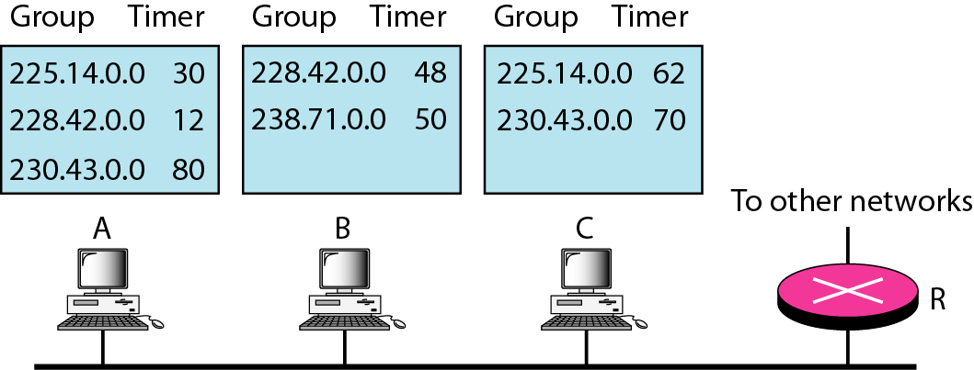
Figure 21.19 Example 21.6
21.<number>

Slide 67
Query Router
Query messages may create a lot of responses.
To prevent unnecessary traffic IGMP designates one router as the query router for each network.
Only this designated router can send the query messages.
21.<number>

Slide 68
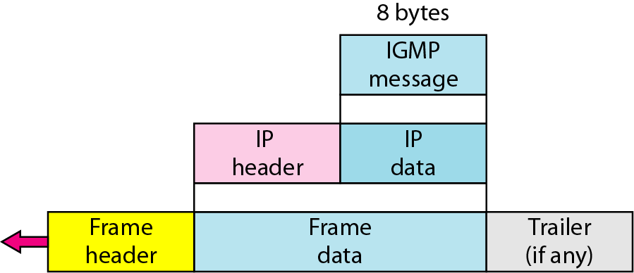
Figure 21.20 Encapsulation of IGMP packet
21.<number>

Slide 69
Note
The IP packet that carries an IGMP packet has a value of 1 in its TTL field.
21.<number>

